Slide 1
Predicting and classifying Openness to experience using multiplex network’s measurements
Gal Samuel
Technion – Israel Institute of Technology
Notes:
Hi everyone, My name is Gal, I’m very excited to be here. ☺
Today I’m going to talk about using multiplex networks to predict openness to experience.

Slide 2



Thanks
Yoed Kenett
Roger Beaty
Massimo Stella
Notes:
Yoed, Massimo, Roger
For their support and contribution to this project.

Slide 3
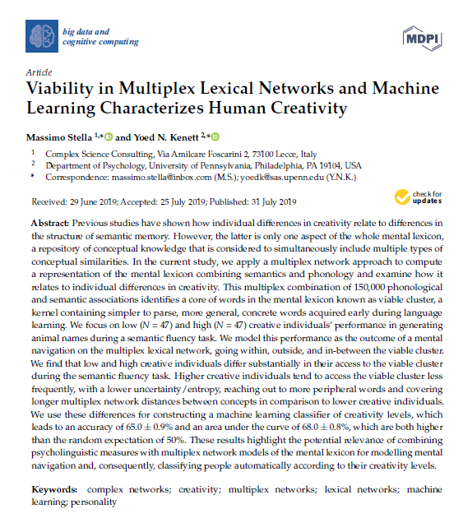
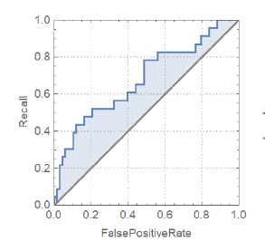
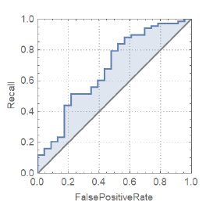
Stella, M., & Kenett, Y. N. (2019)
Notes:
I would also like to say that the current research is largely based on Stella and Kenett 2019, which asked whether creativity can be predicted using cognitive networks.
They found that it is possible to classify low and high creativity using cognitive (multiplex) networks.

Slide 4

Introduction
Openness to Experience
Creativity
Stella, M., & Kenett, Y. N. (2019). Viability in multiplex lexical networks and machine learning characterizes human creativity. Big Data and Cognitive Computing, 3(3), 45.
Notes:
Now I’ll dive into what we’re doing here, starting with openness to experience, which is the trait we are trying to predict in this project.
Personality trait.
It is sometimes described as “the enjoyment of novel experiences and ideas”
Related to semantic memory structure, similarly to creativity.
Was also found to be related to creativity itself
That is important to us because, as I’ve mentioned, this research is largely based on previous work of Massimo stella and Yoed Kenett, which showed that creativity scores can be classified using multiplex network.
Their work, and the relation between openness and creativity, gives us a hint that openness can also be predicted using multiplex networks.

Slide 5
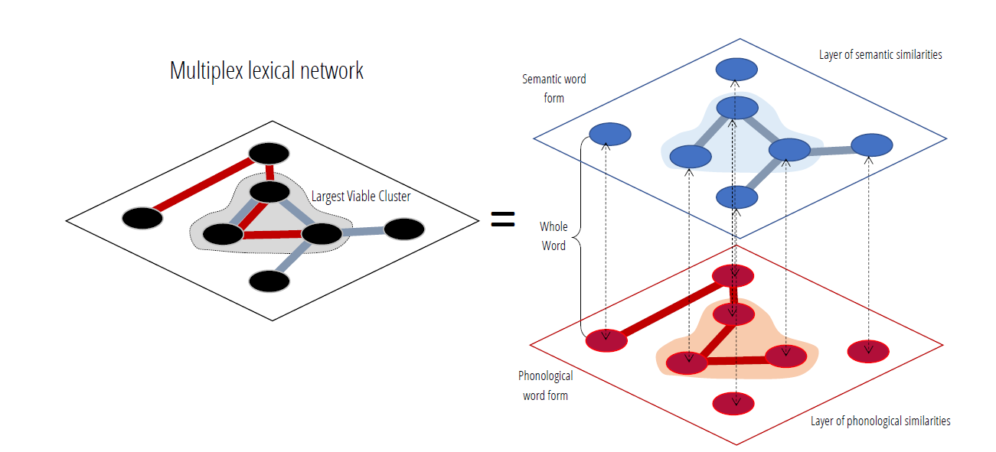

Multiplex networks
Multiplex Networks
Mental Lexicon
Largest Viable Cluster (LVC)
Semantic Fluency Task
Stella, M., & Kenett, Y. N. (2019). Viability in multiplex lexical networks and machine learning characterizes human creativity. Big Data and Cognitive Computing, 3(3), 45.
Notes:
What are multiplex networks?
Multiplex networks - Networks created from a few individual layers which are compressed into one layer – in our case all of these layers are linguistic. Phonological layer, Associative layer, Synonyms layer and Hypernyms layer.
This structure is important to us, because it allows us to model the “Mental lexicon”. Our cognitive structure of language if you may.
Inside the multiplex network there is an important component, the largest viable cluster, or in short, the LVC.
The LVC is the concatenation between the biggest clusters in all individual networks. The cluster of words which are connected across all individual networks.
The multiplex allows us to measure the way subjects navigate through the mental lexicon while completing a semantic fluency task.
A task that requires participants to generate synonyms to a certain word, or generate all the category members they can think of, in a minute.
Finally, once we have the structure (the multiplex) and the path (the semantic fluency replies), we can trace each subject’s walk, and approximate their mental search.

Slide 6
Goals
Research openness to experience using cognitive processes such as mental search.
Predicting and classifying openness to experience score using multiplex network measurements and personal mental navigation properties.
Notes:
In simple words – we want to use the structure (multiplex network) and the way people “walked” on it (the semantic fluency replies) to predict their openness to experience scores.

Slide 7
Method
Data obtained from Beaty et al., 2018 included 163 participants (113 women, mean age = 22.50 years, SD = 5.79)
Openness measurement - NEO-PI-3
Semantic Fluency – “Hot” synonyms
Beaty, R. E., Kenett, Y. N., Christensen, A. P., Rosenberg, M. D., Benedek, M., Chen, Q., Fink, A., Qiu, J., Kwapil, T. R., Kane, M. J., & Silvia, P. J. (2018). Robust prediction of individual creative ability from brain functional connectivity. Proceedings of the National Academy of Sciences, 115(5), 1087–1092. https://doi.org/10.1073/PNAS.1713532115
Notes:
Data was obtained from beaty et al. and included 163 participants.
In this data:
The openness measurement used was Neo-PI-3 standard questionnaire for the big five personality traits, which openness is one of them.
And the semantic fluency task that was used was “hot” synonyms, which meant that participants were required to generate as many synonyms to the word “hot” as possible, in a minute.

Slide 8

Data analysis
Creating the multiplex network
Computing the personalized measurements for each subject
Comparing high and low openness individuals’ measurements and finding the correlation between openness and each measurement
Using machine learning models to classify and predict openness to experience
Notes:
The data analysis process consisted of:
Creating the multiplex – For that we used WordData repository for three layers - synonyms, hypernyms and phonological, and we used small world of words website in order to create the free associations layer.
Computing the features – there were 19 measurements, for example,
Number of responses
Maximum permanence in the LVC – which is the largest streak of words in the LVC, that each subject generated.
Fraction of responses in the LVC out of all of the responses.
We then computed the differences between high and low openness individuals (we took the highest and lowest 30%, acceptable in the literature), and calculated the Pearson correlation between openness and each measurement, in order to have an idea on what are the best features for the next step,
Which was using Machine learning models.

Slide 9
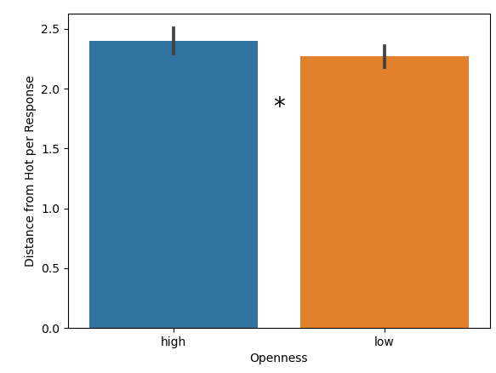
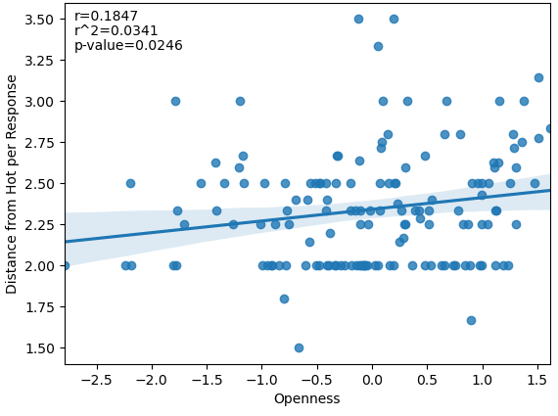
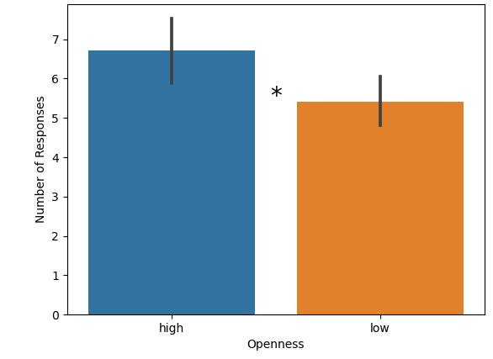
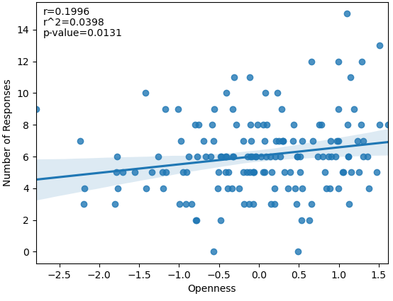
Results – comparison and correlation
Distance from “Hot” per response
Number of responses
Notes:
When comparing the multiplex measurements between low and high openness subjects, we found 10 significant differences in mann whitney test.
When calculating Pearson r between multiplex measurements and openness we found 7 significant relations.
These are two examples of each.

Slide 10
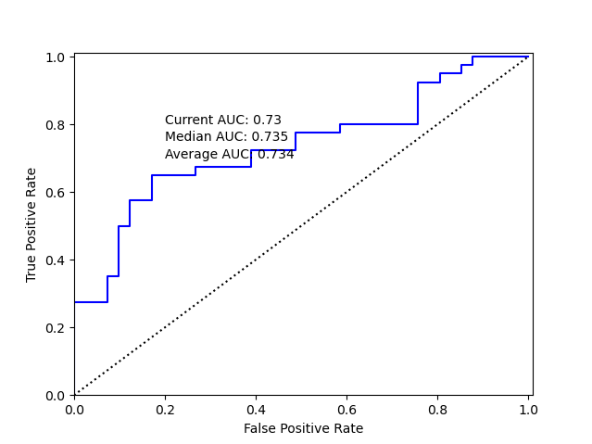
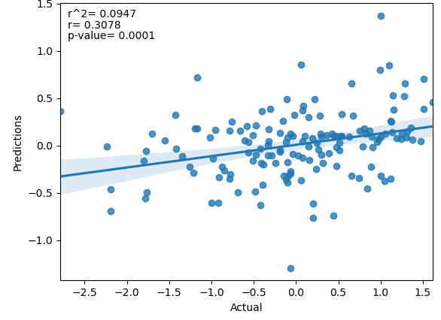
Results – Classification and Prediction
Classification
AUC = 0.73
Prediction
R=0.31
Notes:
The best machine learning results were
AUC of 0.73, which means that in 73% of the time our model succeeded in classifying whether the subject is high or low in openness.
R of 0.31, which is the correlation between the models’ predictions based on the features, and the actual openness scores.
There is more information about the specific models.
No more after here.
left is leave one out, random forest, 100 runs average
Right is Pred
Using loo
Features used were: Fraction of Responses in LVC, Entropy of LVC Accesses, Max Permanence in LVC, Norm1

Slide 11
Conclusion and discussion
Evidence for mental lexicon’s relation to personality
Next: Predicting creativity
Larger dataset expected to increase model power
Notes:
Finally,
Therefore, it is indeed possible to some extent, to classify and/or predict openness to experience from multiplex networks measurements.
Our future steps include using similar methods in order to predict creativity scores, with a larger dataset.
We expect the larger dataset to increase our model power, and therefore yield interesting results.

Slide 12

Notes:
Thank you all for listening.
Any questions?
Classification – Random forest yielded the best scores
Prediction – linear regression yielded (6 features)
Both with leave one out cross validation.
It doesn’t mean that 31% of the scores were accurately predicted, but that the order and ascend of scores were similar between predicted and actual.

Slide 13
